Slide 1
NEW YORK CITY AIRBNB
INTRODUCTION
Process
Insights
Summary

Slide 2
INTRODUCTION
Since its establishment in 2008, Airbnb has empowered both guests and hosts to enrich their travel experiences and embrace a more personalized approach to exploring the world. This comprehensive dataset details the listing activity and metrics in NYC, NY for 2019, equipping users with valuable insights to better understand hosts, geographical availability, and essential metrics for informed decision-making and analysis.

Slide 3
PROCESS
Data gathering.
Data cleaning
Data modelling
Data analysis
Uncovering insights

Slide 4
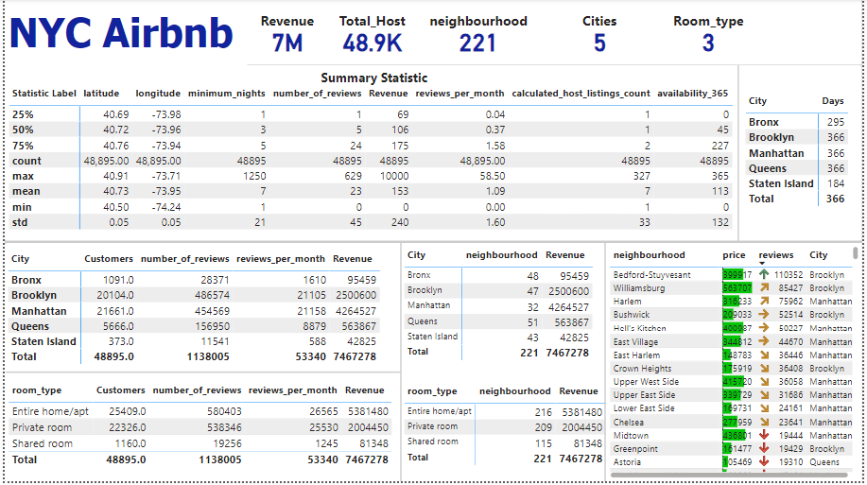
Data Over View

Slide 5
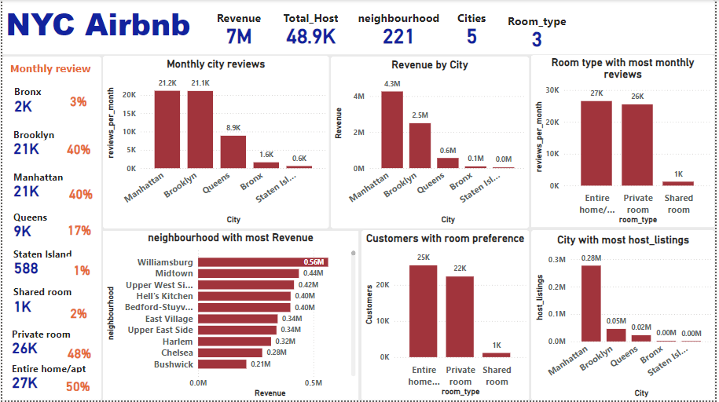

Slide 6
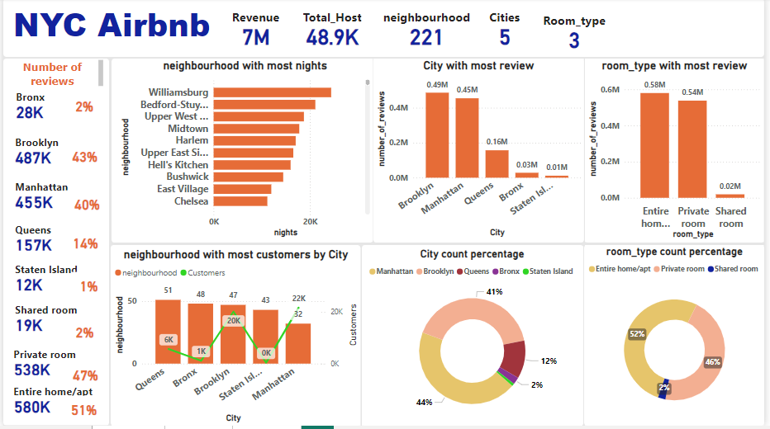

Slide 7
KEY METRICS
REVENUE: $7M
CUSTOMERS: 48.9K
NEIGHBOURHOOD: 221
CITIES: 5
ROOM_TYPE: 3

Slide 8
INSIGHT
Analysis by City
In 2019, New York City Airbnb had listings in 5 cities with a total of 221 neighborhoods. Each Airbnb offered three room types to cater to customer preferences. The data for 2019 shows that approximately 48.9k people stayed at these Airbnbs, generating a total of $7 million in revenue for that year. Here are some of the insights obtained from the data.
Manhattan: Discover the vibrant city of Manhattan, New York, boasting 32 unique neighborhoods. With 21.2k monthly reviews, generating $4.3M in revenue, 227k host listings, and 455k yearly reviews, Manhattan welcomes over 22k customers to experience its dynamic energy and diverse offerings.
Brooklyn: With 47 vibrant neighborhoods, 21.1k monthly reviews, and $2.5M in revenue, Brooklyn is bustling with 46k host listings, 487k yearly reviews, and 20k satisfied customers.
Queens: Discover the diverse borough of Queens, boasting 51 unique neighborhoods, with 8.9k glowing monthly reviews and a remarkable $564k in revenue. With 23k host listings and 157k yearly reviews, our vibrant community welcomes 6k customers to experience the best of Queens.

Slide 9
Bronx: Queens has 48 neighborhoods, 1.6k monthly reviews, $95k in revenue, 2k host listings, 28k yearly reviews, and 1k customers.
Staten Island: Staten Island has 43 neighborhoods, 1.6k monthly reviews, $43k in revenue, 865k host listings, 12k yearly reviews, and 373 customers.
Entire home/apt: Entire home/apt available in 216 neighborhoods, 27k monthly reviews, $5M revenue, 580k yearly reviews, and 25k customers.
Private room: Private room available in 209 neighborhoods, with 26k monthly reviews, generating $2M in revenue, and serving 22k customers with 538k yearly reviews.
Shared room: Shared rooms are available in 115 neighborhoods, with 1k monthly reviews, generating $81k in revenue, and serving 1k customers annually..
Analysis by Room type

Slide 10
SUMMARY
This analysis has provided key findings, insights into customer preferences, city trends, and potential recommendations for business growth and improvement for New York City Airbnb. The results obtained from this analysis highlight opportunities for increased profitability and user satisfaction.

